Slide 1
CIS 4526 Foundations of Machine Learning
Chapter 7
Universal Machine Learning Concepts Part I

Slide 2
Common Theme, Toolbox and Research workflow in Data Science
Apply different algorithms to solve different problems
based on the same theme and research workflow
Algorithms
SVM
KNN
Naïve Bayes
Neural Network
Logistics Regression
NLP
Problems
Regression
Classification
Recommendation System
Clustering
Association
Theme
Research Workflow
Toolbox

Slide 3




Common Data Scientists Toolbox
Every professional requires mastery of their tools box
Every profession has a standard protocol

Slide 4
Outline
Criteria for finding the best-fitted model parameters
Cost Function and Performance Metric
Gradient Descent
Train-Test Split
K-Fold Cross Validation
Bias and Variance Tradeoff
Regularization

Slide 5
Cost Function, Gradient Descent, Performance Metric
Steps in finding the best fitted model
Choose the structure of the model (Linear, Logistics, SVM, etc)
Define a cost function with variable weights (aka model coefficients, model parameters)
Use a numerical method, say the Gradient Descent method, to minimize the Cost function.
Pick a performance metric, use it to determine the “goodness-of-fit”

Slide 6
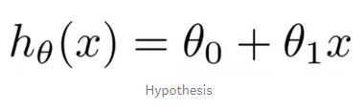
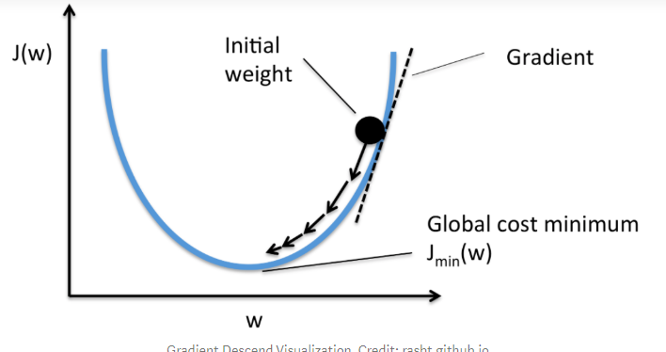
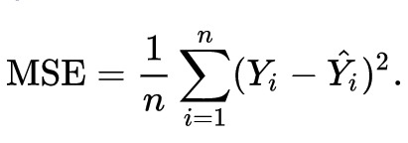
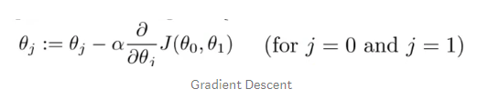
Gradient Descent in Linear Regression
In practice, we just call the “Fit” method from the library
https://medium.com/@lachlanmiller_52885/machine-learning-week-1-cost-function-gradient-descent-and-univariate-linear-regression-8f5fe69815fd

Slide 7
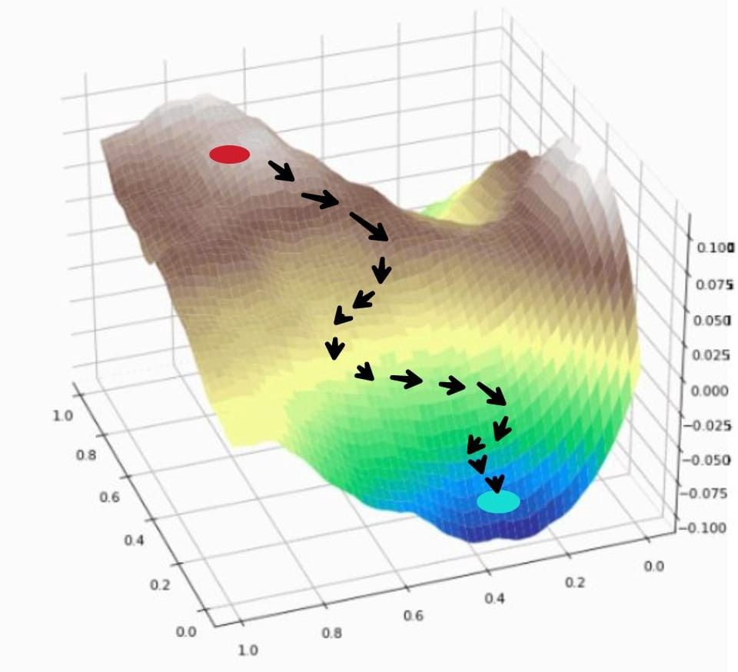
Gradient Descent (2-dimensional)
Idea:
❏ start somewhere
❏ take steps based on the gradient vector of the current position till convergence
start point
look for a new direction
Convergence:
❏ happens when changes between two steps < ɛ
end point (minimum)

Slide 8




Gradient Descent (chapter 5 in the textbook)

Slide 9
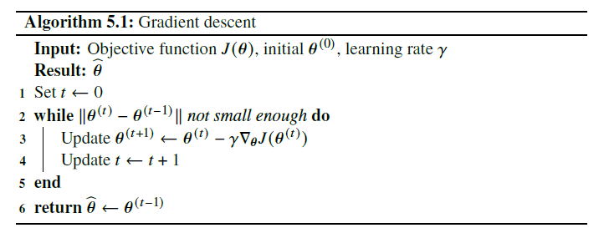
Gradient Descent (chapter 5 in the textbook)

Slide 10
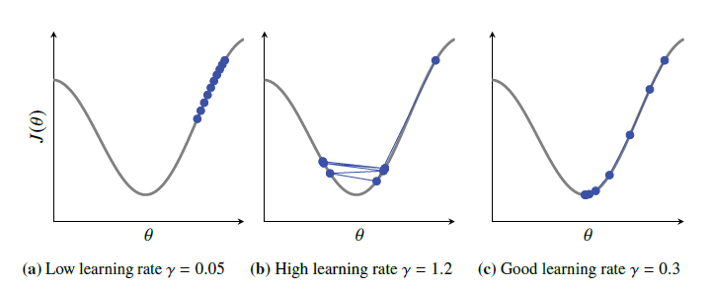
Effect of different learning rate

Slide 11
Outline
Criteria for finding the best-fitted model parameters
Cost Function and Performance Metric
Gradient Descent
Train-Test Split
K-Fold Cross Validation
Bias and Variance Tradeoff
Regularization

Slide 12
Train Test Split
In this course so far, we do
Train-Test Split
But a better way is
Train/Validate and Test Split

Slide 13
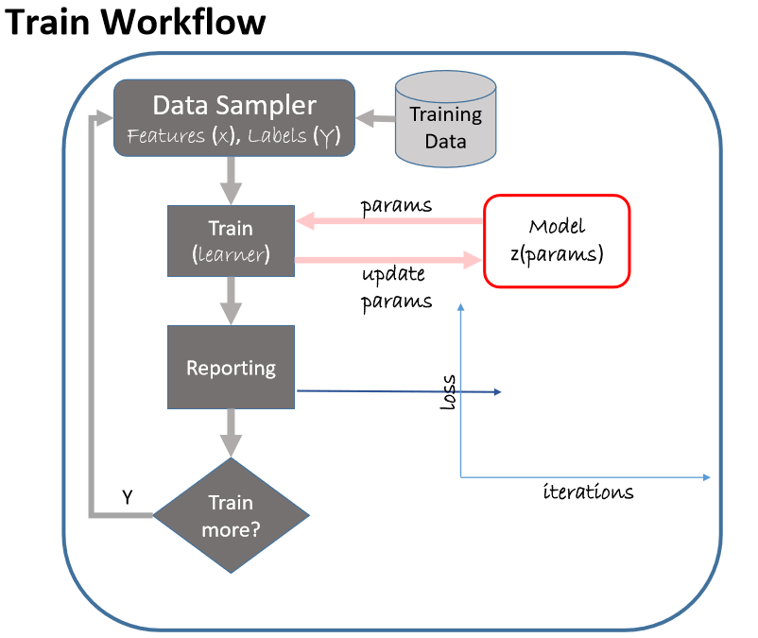
Research Workflow (Train-Validate-Test Cycle)
Reference: Microsoft Professional Program in Artificial Intelligence

Slide 14
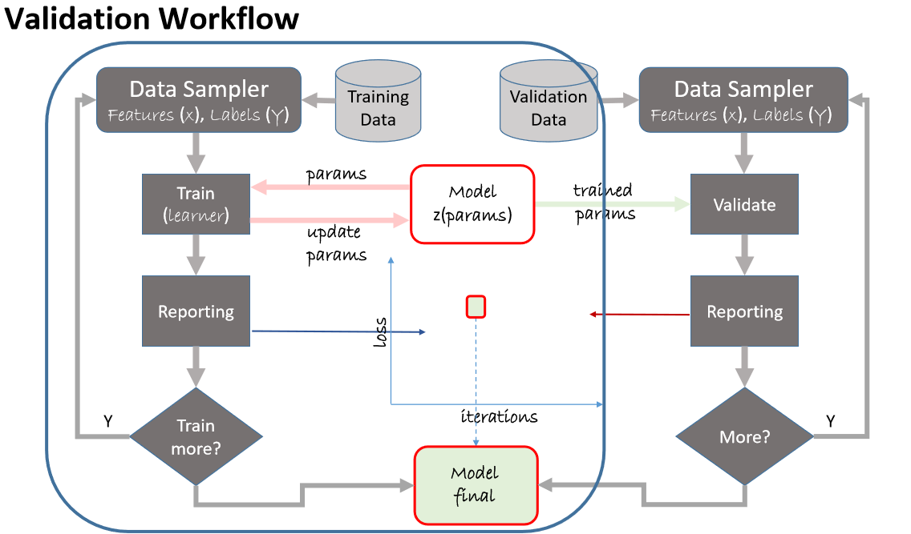
Research Workflow (Train-Validate-Test Cycle)
Reference: Microsoft Professional Program in Artificial Intelligence

Slide 15
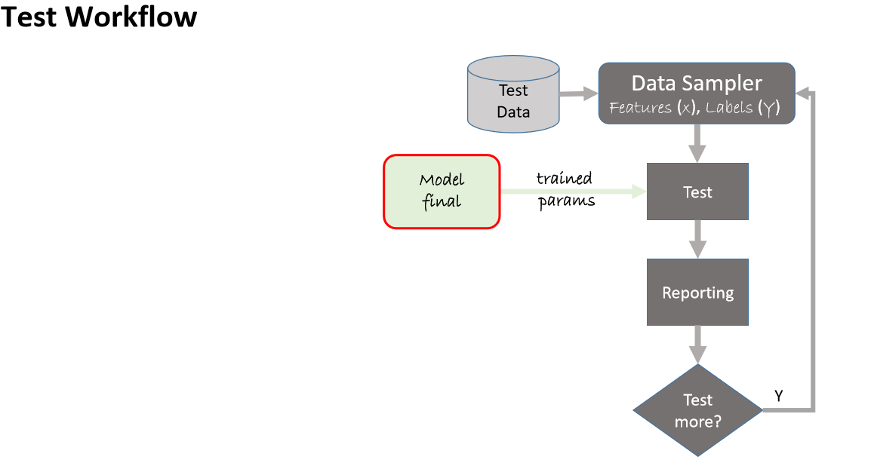
Research Workflow (Train-Validate-Test Cycle)
Reference: Microsoft Professional Program in Artificial Intelligence

Slide 16
Outline
Criteria for finding the best-fitted model parameters
Cost Function and Performance Metric
Gradient Descent
Train-Test Split
K-Fold Cross Validation
Bias and Variance Tradeoff
Regularization

Slide 17








K-fold Cross Validation
Divide the whole dataset into k parts
At each iteration, save one part as the testing (validation) data, train the model with the other (k-1) parts
Calculate the model performance metric on the testing part
Calculate the mean
Check if the model result change dramatically when using different training set
k-fold cross-validation explained in English

Slide 18
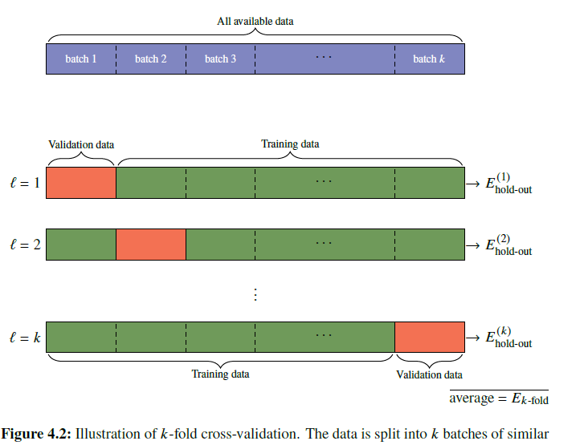
K-fold cross validation
Read Chapter 4 of the textbook

Slide 19
Outline
Criteria for finding the best-fitted model parameters
Cost Function and Performance Metric
Gradient Descent
Train-Test Split
K-Fold Cross Validation
Bias and Variance Tradeoff
Regularization

Slide 20
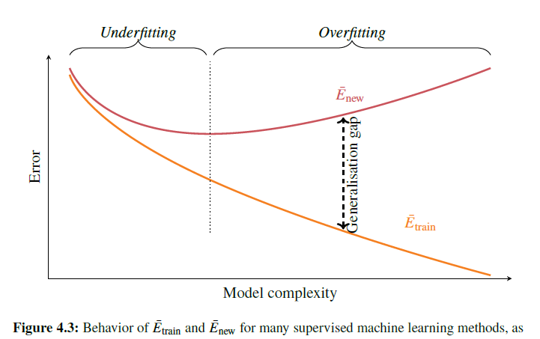
Bias-Variance Tradeoff (again)

Slide 21
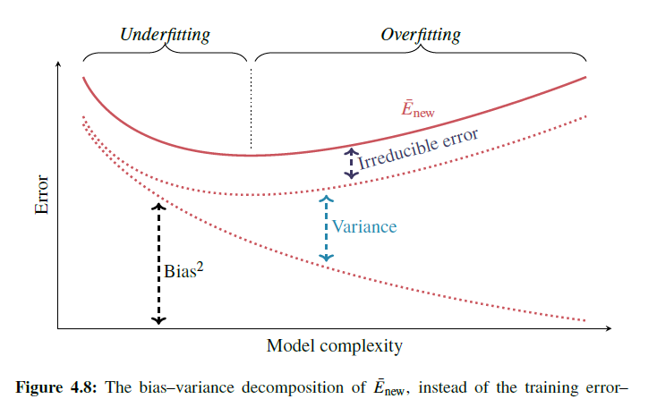
Bias-Variance Tradeoff (again)

Slide 22
Regularization
Dilemma: Too simple model will underfit (high bias, low variance) while more complicated model will overfit (low bias, high variance)
Is there any tools to help finding the right balance?
Idea is to penalize complicated model automatically
In performance model, use adjusted R-square instead of R-square so that more parameters does not automatically guarantee a higher performance score
Examples of Regularization techniques
Linear or Logistic regression
Ridge regularization
Lasso regularization
Dropout in deep learning (will discuss in the Deep Learning lectures)

Slide 23
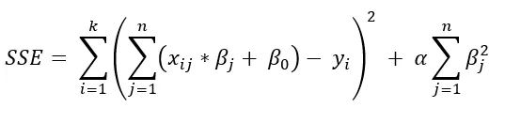
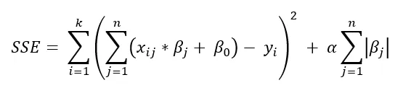
Regularization in Linear Regression
Ridge Regularization
Lasso Regularization
$α$ is the so-called regularization parameters. It controls how much regularization we want.
The last term make the weight vectors cannot be too big (preventing overfitting)
Regularization in Machine Learning | by Ritwick Roy | Towards Data Science

Slide 24
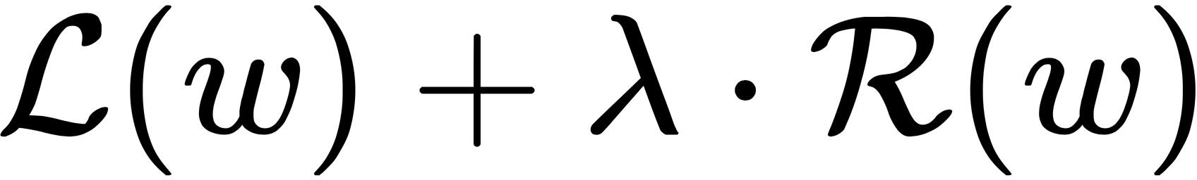

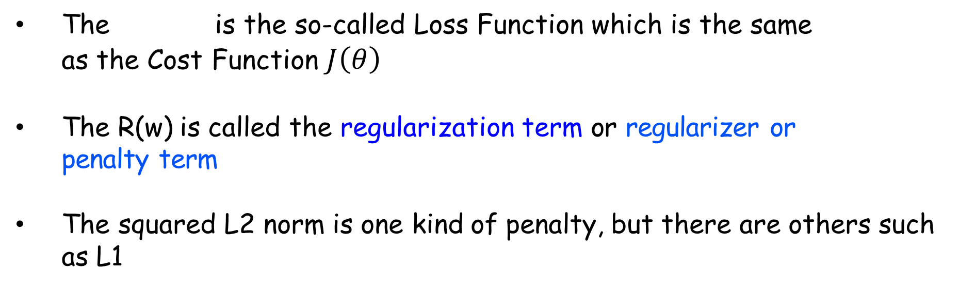
Regularization in general
The is the so-called Loss Function which is the same as the Cost Function $J\left(θ\right)$
The R(w) is called the regularization term or regularizer or penalty term
The squared L2 norm is one kind of penalty, but there are others such as L1

Slide 25

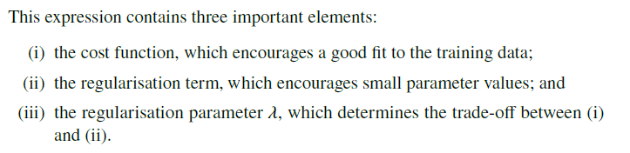
General Explicit Regularization (from textbook)

Slide 26
Regularization
❏ Regularization helps the computational problem so that gradient descent won’t try to make some feature weights grow larger and larger;
❏ In logistic regression, probably no practical difference whether your classifier predicts probability .99 or .9999 for a label, but weights would need to be much larger to reach .9999.
❏ This also helps with generalization because it won’t give large weight to features unless there is sufficient evidence that they are useful

